Slide 1
Expectations and parameter estimation
CS771: Introduction to Machine Learning
Nisheeth

Slide 2

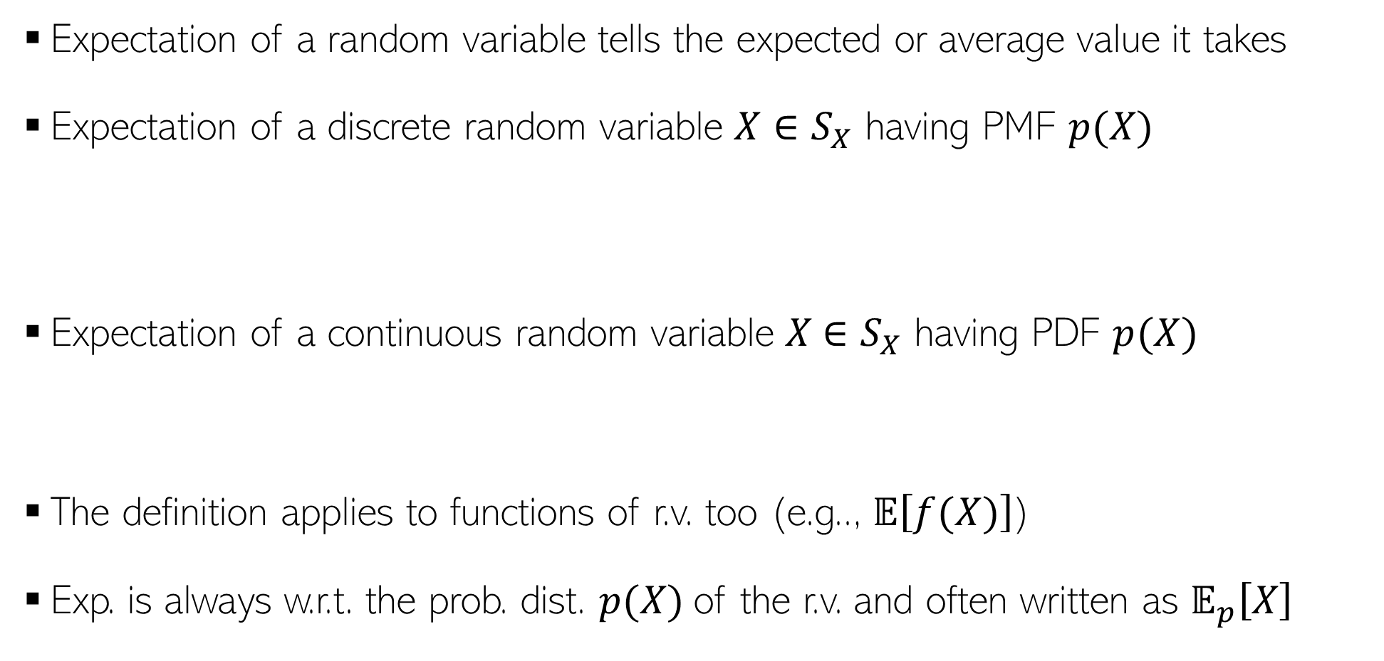

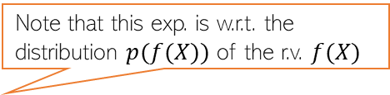
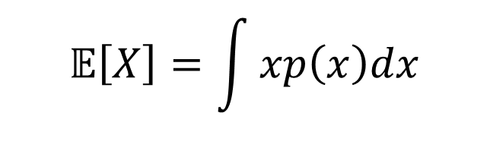
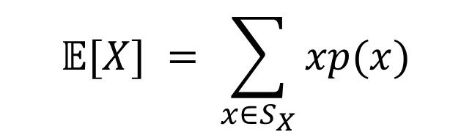

Expectation
Expectation of a random variable tells the expected or average value it takes
Expectation of a discrete random variable $X∈S_{X}$ having PMF $p(X)$
Expectation of a continuous random variable $X$ $∈S_{X}$ having PDF $p(X)$
The definition applies to functions of r.v. too (e.g.., $𝔼\left[f(X)\right]$)
Exp. is always w.r.t. the prob. dist. $p(X)$of the r.v. and often written as $𝔼_{p}\left[X\right]$
$$𝔼[X] = \sum_{x∈S_{X}}{xp(x)}$$
Probability that $X = x$
$$𝔼\left[X\right]=\int{xp\left(x\right)dx}$$
Probability density at $X = x$
Note that this exp. is w.r.t. the distribution $p(f(X))$ of the r.v. $f(X)$
$$x∈S_{X}$$
Often the subscript is omitted but do keep in mind the underlying distribution

Slide 3
Expectation: intuition
Recall the following probability distribution of patient arrivals:
x
10
11
12
13
14
P(x)
.4
.2
.2
.1
.1

Slide 4
Non-trivial discrete probabilities
Take the example of 5 coin tosses. What’s the probability that you flip exactly 3 heads in 5 coin tosses?

Slide 5
A discrete distribution: binomial
A fixed number of observations (trials), n
e.g., 15 tosses of a coin; 20 patients; 1000 people surveyed
A binary outcome
e.g., head or tail in each toss of a coin; disease or no disease
Generally called “success” and “failure”
Probability of success is p, probability of failure is 1 – p
Constant probability for each observation
e.g., Probability of getting a tail is the same each time we toss the coin

Slide 6
Binomial distribution
Solution:
One way to get exactly 3 heads: HHHTT
What’s the probability of this exact arrangement?
P(heads)xP(heads) xP(heads)xP(tails)xP(tails) =(1/2)³ x (1/2)²
Another way to get exactly 3 heads: THHHT
Probability of this exact outcome = (1/2)¹ x (1/2)³ x (1/2)¹ = (1/2)³ x (1/2)²

Slide 7
Binomial distribution
In fact, (1/2)³ x (1/2)² is the probability of each unique outcome that has exactly 3 heads and 2 tails.
So, the overall probability of 3 heads and 2 tails is:
(1/2)³ x (1/2)² + (1/2)³ x (1/2)² + (1/2)³ x (1/2)² + ….. for as many unique arrangements as there are—but how many are there??

Slide 8
Outcome Probability
THHHT (1/2)³ x (1/2)²
HHHTT (1/2)³ x (1/2)²
TTHHH (1/2)³ x (1/2)²
HTTHH (1/2)³ x (1/2)²
HHTTH (1/2)³ x (1/2)²
HTHHT (1/2)³ x (1/2)²
THTHH (1/2)³ x (1/2)²
HTHTH (1/2)³ x (1/2)²
HHTHT (1/2)³ x (1/2)²
THHTH (1/2)³ x (1/2)²
10 arrangements x (1/2)³ x (1/2)²
The probability of each unique outcome (note: they are all equal)
ways to arrange 3 heads in 5 trials
₅C₃ = 5!/3!2! = 10

Slide 9
∴P(3 heads and 2 tails) = x P(heads)³ x P(tails)² =
10 x (½)⁵⁼31.25%

Slide 10
Binomial distribution function: X= the number of heads tossed in 5 coin tosses
p(x)
p(x)
x
0
1
2
3
4
5
number of heads
number of heads

Slide 11
Binomial distribution, generally
Note the general pattern emerging → if you have only two possible outcomes (call them 1/0 or yes/no or success/failure) in n independent trials, then the probability of exactly X “successes”=
n = number of trials
1-p = probability of failure
X = # successes out of n trials
p = probability of success

Slide 12
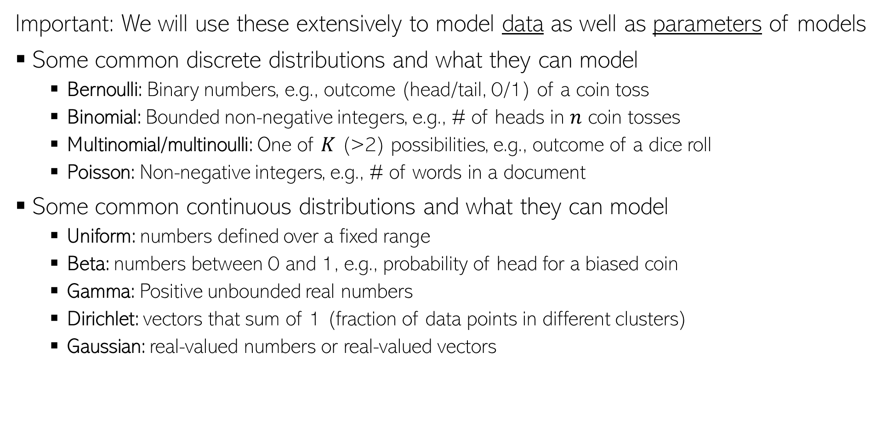
Common Probability Distributions
Important: We will use these extensively to model data as well as parameters of models
Some common discrete distributions and what they can model
Bernoulli: Binary numbers, e.g., outcome (head/tail, 0/1) of a coin toss
Binomial: Bounded non-negative integers, e.g., # of heads in $n$ coin tosses
Multinomial/multinoulli: One of $K$ (>2) possibilities, e.g., outcome of a dice roll
Poisson: Non-negative integers, e.g., # of words in a document
Some common continuous distributions and what they can model
Uniform: numbers defined over a fixed range
Beta: numbers between 0 and 1, e.g., probability of head for a biased coin
Gamma: Positive unbounded real numbers
Dirichlet: vectors that sum of 1 (fraction of data points in different clusters)
Gaussian: real-valued numbers or real-valued vectors

Slide 13
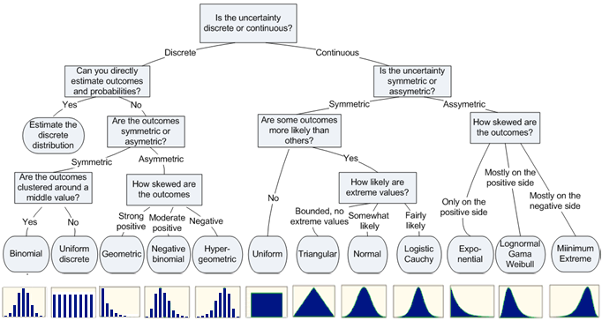

Slide 14
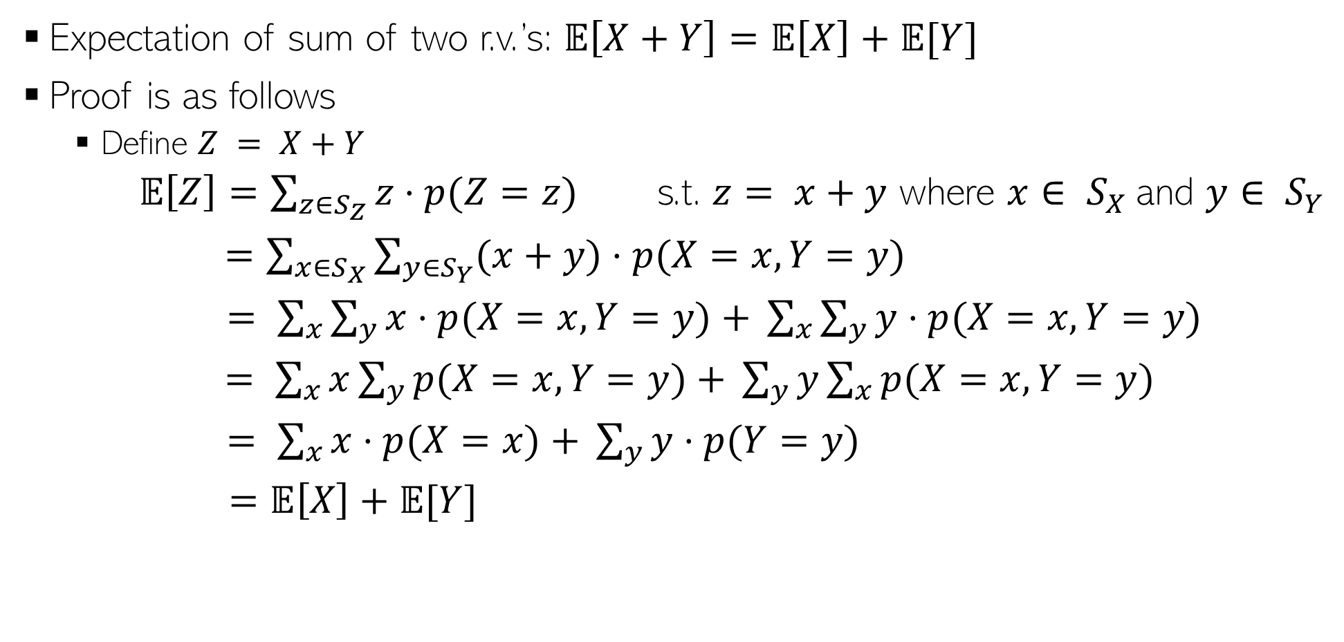
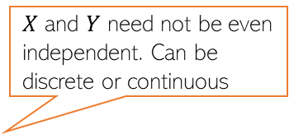
Expectation: A Few Rules
$X$ and $Y$ need not be even independent. Can be discrete or continuous
Expectation of sum of two r.v.’s: $𝔼\left[X+Y\right]=𝔼\left[X\right]+𝔼[Y]$
Proof is as follows
Define $Z = X+Y$
$𝔼\left[Z\right]=\sum_{z∈S_{Z}}{z⋅p(Z=z)}$ s.t. $z= x+y$ where $x∈ S_{X}$and $y∈ S_{Y}$
$=\sum_{x∈S_{X}}{\sum_{y∈S_{Y}}{(x+y)⋅p(X=x,Y=y)}}$
$= \sum_{x}{\sum_{y}{x⋅p(X=x,Y=y)}}$ $+ \sum_{x}{\sum_{y}{y⋅p(X=x,Y=y)}}$
$= \sum_{x}{x\sum_{y}{p(X=x,Y=y)}}$ $+ \sum_{y}{y\sum_{x}{p(X=x,Y=y)}}$
$= \sum_{x}{x⋅p(X=x)}$ $+ \sum_{y}{y⋅p(Y=y)}$
$=𝔼\left[X\right]+𝔼[Y]$
Used the rule of marginalization of joint dist. of two r.v.’s

Slide 15

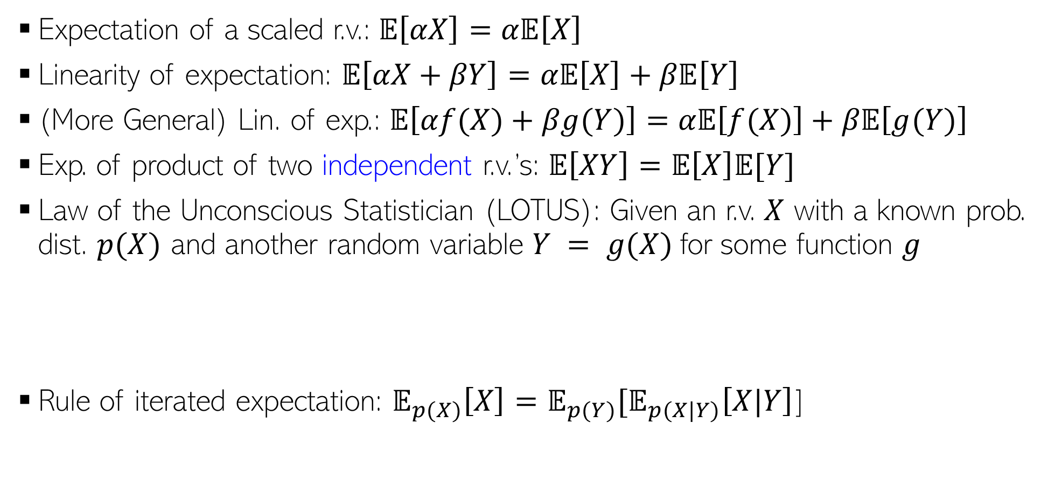

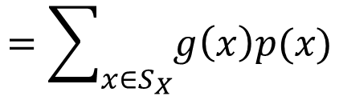
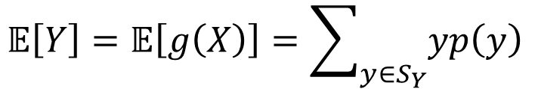



Expectation: A Few Rules (Contd)
$α$is a real-valued scalar
$α$and $β$are real-valued scalars
Expectation of a scaled r.v.: $𝔼\left[αX\right]=α𝔼\left[X\right]$
Linearity of expectation: $𝔼\left[αX+βY\right]=α𝔼\left[X\right]+β𝔼\left[Y\right]$
(More General) Lin. of exp.: $𝔼\left[αf(X)+βg(Y)\right]=α𝔼\left[f(X)\right]+β𝔼\left[g(Y)\right]$
Exp. of product of two independent r.v.’s: $𝔼\left[XY\right]=𝔼\left[X\right]𝔼[Y]$
Law of the Unconscious Statistician (LOTUS): Given an r.v. $X$ with a known prob. dist. $p(X)$ and another random variable $Y = g(X)$for some function $g$
Rule of iterated expectation: $𝔼_{p(X)}\left[X\right]=𝔼_{p(Y)}[𝔼_{p(X|Y)}\left[X|Y\right]$]
$f$ and $g$ are arbitrary functions.
Requires finding $p(Y)$
Requires only $p(X)$ which we already have
$$𝔼\left[Y\right]=𝔼\left[g\left(X\right)\right]=\sum_{y∈S_{Y}}{yp\left(y\right) }$$
$$=\sum_{x∈S_{X}}{g\left(x\right)p(x)}$$

Slide 16
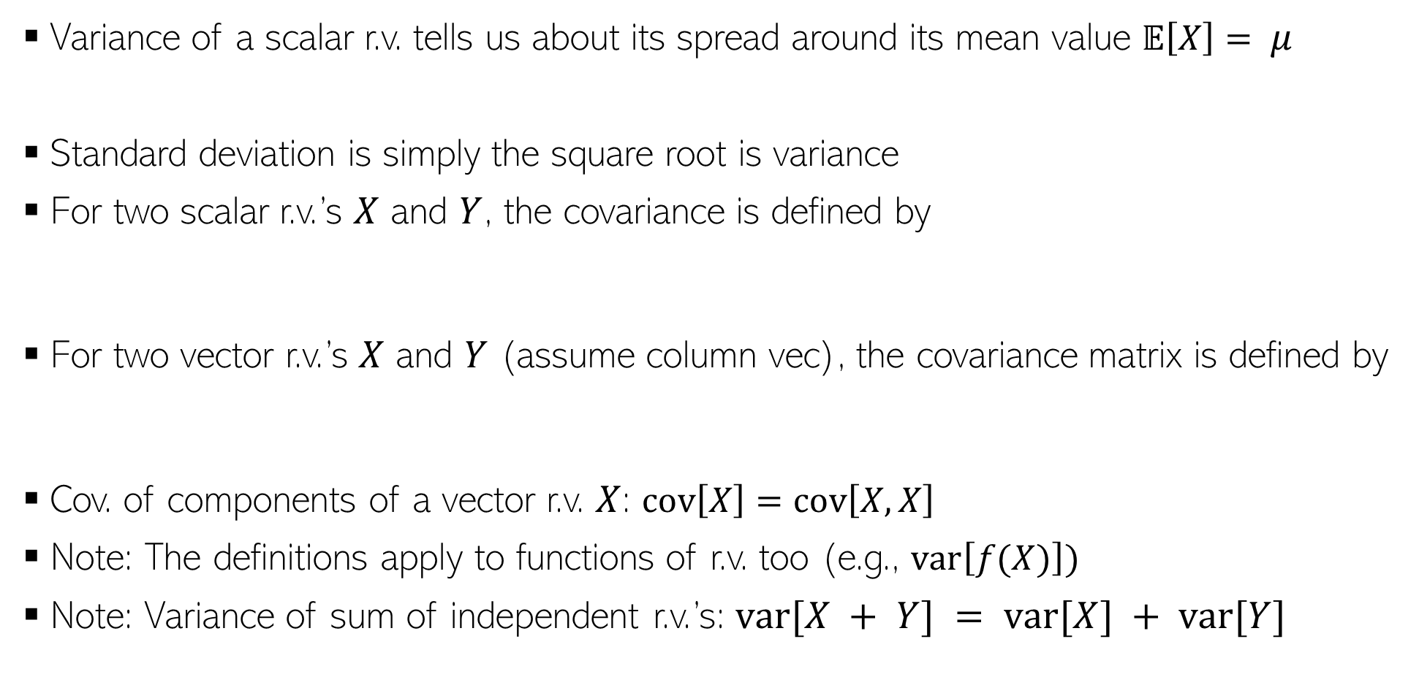
Variance and Covariance
Variance of a scalar r.v. tells us about its spread around its mean value $𝔼\left[X\right]= μ$
Standard deviation is simply the square root is variance
For two scalar r.v.’s $X$ and $Y$, the covariance is defined by
For two vector r.v.’s $X$ and $Y$ (assume column vec), the covariance matrix is defined by
Cov. of components of a vector r.v. $X$: $cov\left[X\right]=cov\left[X,X\right]$
Note: The definitions apply to functions of r.v. too (e.g., $var\left[f(X)\right])$
Note: Variance of sum of independent r.v.’s: $var[X + Y] = var[X] + var[Y]$
$$var\left[X\right]=𝔼\left[{\left(X−μ\right)}^{2}\right]=𝔼\left[X^{2}\right] −μ^{2}$$
$$cov\left[X,Y\right]=𝔼\left[\{X−𝔼[X]\}\{Y−𝔼[Y]\}\right]=𝔼\left[XY\right]−𝔼[X]𝔼[Y]$$
$$cov\left[X,Y\right]=𝔼\left[\{X−𝔼[X]\}\{Y^{⊤}−𝔼[Y^{⊤}]\}\right]=𝔼\left[XY^{⊤}\right]−𝔼[X]𝔼[Y^{⊤}]$$

Slide 17
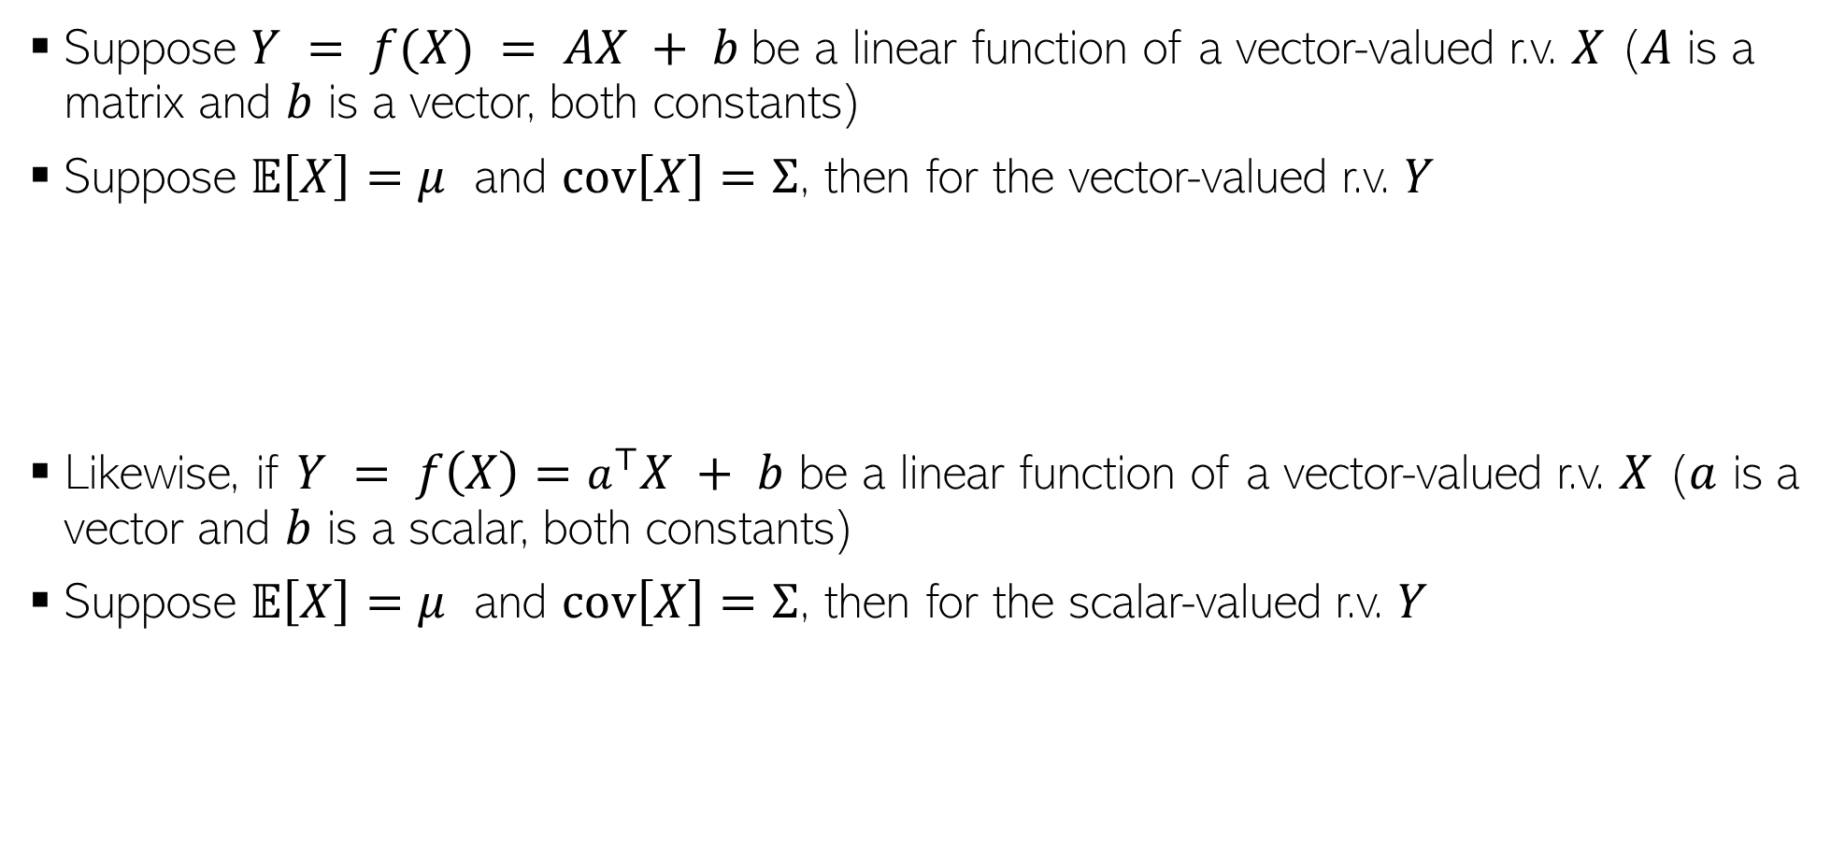
Transformation of Random Variables
Suppose $Y = f(X) = AX + b$be a linear function of a vector-valued r.v. $X$ ($A$ is a matrix and $b$ is a vector, both constants)
Suppose $𝔼\left[X\right]=μ$ and $cov\left[X\right]=Σ$, then for the vector-valued r.v. $Y$
Likewise, if $Y = f\left(X\right)=a^{⊤}X + b$ be a linear function of a vector-valued r.v. $X$ ($a$ is a vector and $b$ is a scalar, both constants)
Suppose $𝔼\left[X\right]=μ$ and $cov\left[X\right]=Σ$, then for the scalar-valued r.v. $Y$
$$𝔼\left[Y\right]=𝔼\left[AX+b\right]=Aμ+b$$
$$cov\left[Y\right]=cov\left[AX+b\right]=AΣA^{⊤}$$
$$𝔼\left[Y\right]=𝔼\left[a^{⊤}X + b\right]=a^{⊤}μ+b$$
$$var\left[Y\right]=var\left[a^{⊤}X + b\right]=a^{⊤}Σa$$

Slide 18
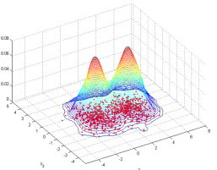
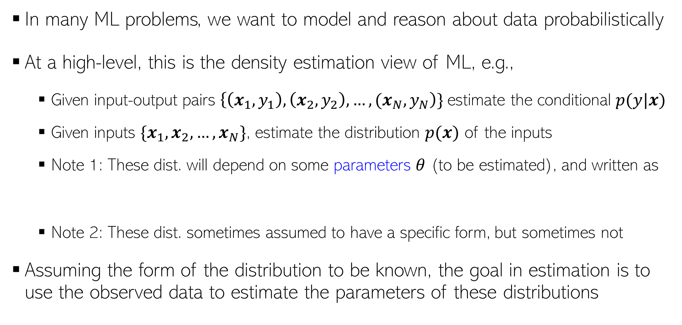

Probabilistic ML: Some Motivation
In many ML problems, we want to model and reason about data probabilistically
At a high-level, this is the density estimation view of ML, e.g.,
Given input-output pairs $\left\{\left(x_{1},y_{1}\right),\left(x_{2},y_{2}\right),…,{(x}_{N},y_{N}\right)\}$estimate the conditional $p(y|x)$
Given inputs $\{x_{1},x_{2},…,x_{N}\}$, estimate the distribution $p(x)$ of the inputs
Note 1: These dist. will depend on some parameters $θ$ (to be estimated), and written as
Note 2: These dist. sometimes assumed to have a specific form, but sometimes not
Assuming the form of the distribution to be known, the goal in estimation is to use the observed data to estimate the parameters of these distributions
p(y=green|x)
p(y=red|x)
$$p(y|x,θ) \text{or} p(x|θ)$$

Slide 19






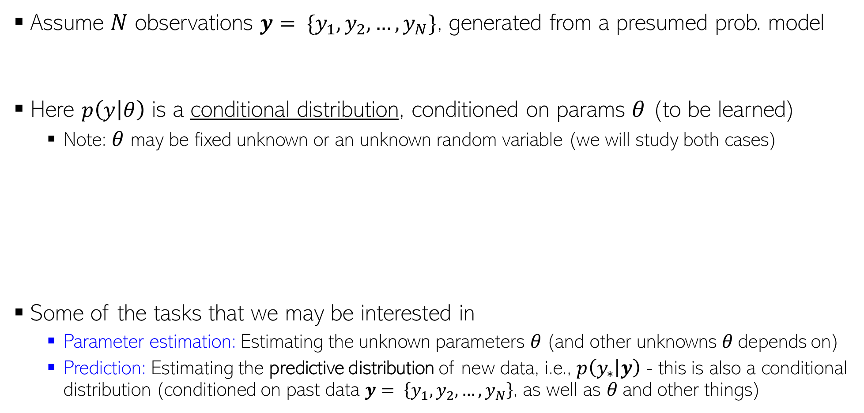
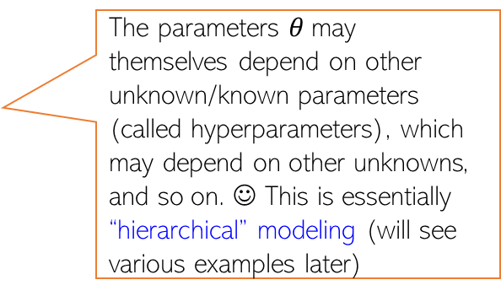
Probabilistic Modeling: The Basic Idea
Assume $N$ observations $y= \{y_{1},y_{2},…,y_{N}\}$, generated from a presumed prob. model
Here $p\left(y | θ\right)$ is a conditional distribution, conditioned on params $θ$ (to be learned)
Note: $θ$ may be fixed unknown or an unknown random variable (we will study both cases)
Some of the tasks that we may be interested in
Parameter estimation: Estimating the unknown parameters $θ$(and other unknowns $θ$depends on)
Prediction: Estimating the predictive distribution of new data, i.e., $p\left(y_{∗} | y\right)$ - this is also a conditional distribution (conditioned on past data $y= \left\{y_{1},y_{2},…,y_{N}\right\}$, as well as $θ$and other things)
$y_{n}∼p\left(y | θ\right) ∀n$
$$\text{(}\text{assumed} \text{independently}\text{ \& }\text{identically} \text{distributed}\text{ (}\text{i}\text{.}\text{i}\text{.}\text{d}\text{.)}\text{)}$$
The parameters $θ$may themselves depend on other unknown/known parameters (called hyperparameters), which may depend on other unknowns, and so on. ☺ This is essentially “hierarchical” modeling (will see various examples later)
$$θ$$
Such diagrams are usually called the
“plate notation”
The Predictive dist. tells us how likely each possible value of a new observation $y_{∗}$is. Example: if $y_{∗}$denotes the outcome of a coin toss, then what is $p\left(y_{∗}="head" | y\right)$, given $N$ previous coin tosses
$y= \{y_{1},y_{2},…,y_{N}\}$
$$y_{n}$$
$$N$$

Slide 20




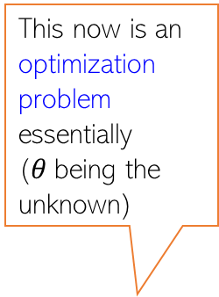
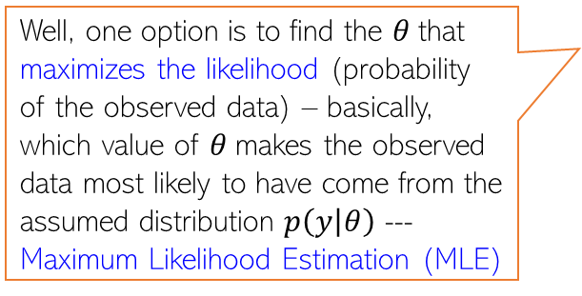
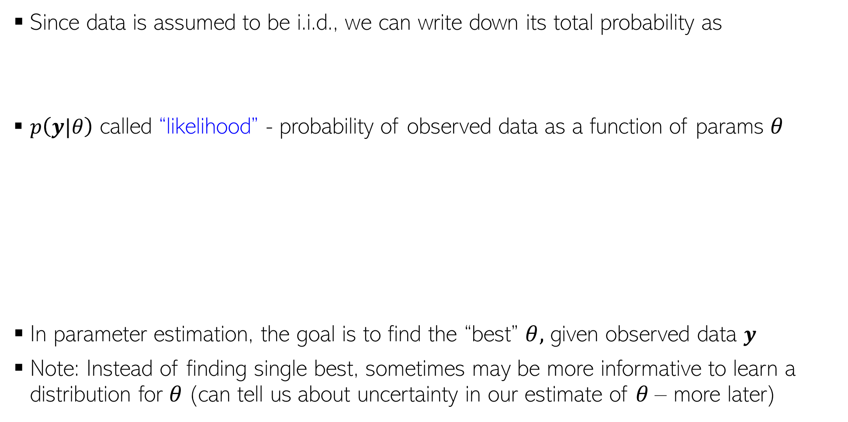

Parameter Estimation in Probabilistic Models
This now is an optimization problem essentially ($θ$being the unknown)
Since data is assumed to be i.i.d., we can write down its total probability as
$p\left(y|θ\right)$ called “likelihood” - probability of observed data as a function of params $θ$
In parameter estimation, the goal is to find the “best” $θ,$ given observed data $y$
Note: Instead of finding single best, sometimes may be more informative to learn a distribution for $θ$(can tell us about uncertainty in our estimate of $θ$– more later)
$p\left(y|θ\right)=p\left(y_{1},y_{2},…,y_{N} | θ\right)$ $= \prod_{n=1}^{N}{p(y_{n}|θ)}$
$$p\left(y|θ\right)$$
Well, one option is to find the $θ$that maximizes the likelihood (probability of the observed data) – basically, which value of $θ$makes the observed data most likely to have come from the assumed distribution $p\left(y | θ\right)$ --- Maximum Likelihood Estimation (MLE)
How do I find the best $θ$ ?
$$θ_{opt}=θ_{MLE}$$
$$θ$$

Slide 21
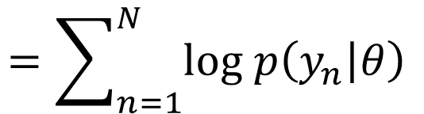
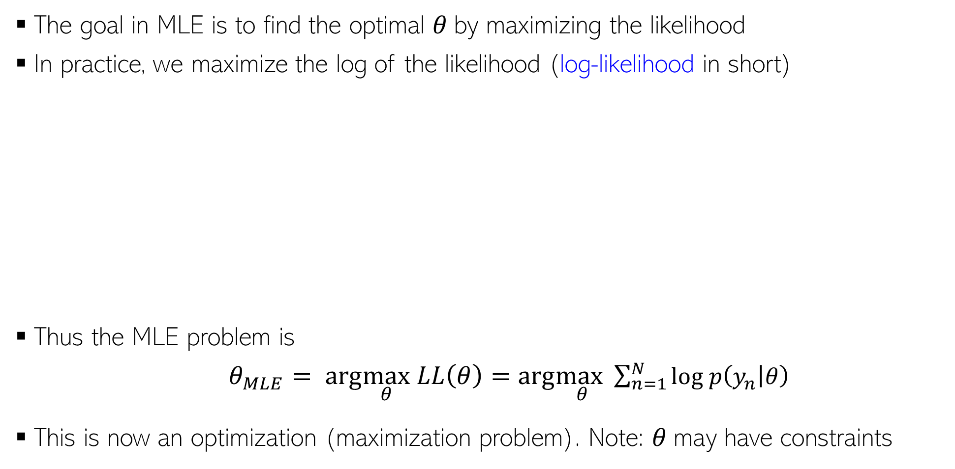
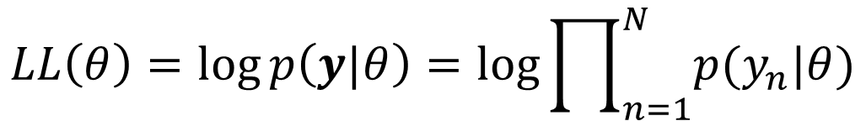



Maximum Likelihood Estimation (MLE)
The goal in MLE is to find the optimal $θ$by maximizing the likelihood
In practice, we maximize the log of the likelihood (log-likelihood in short)
Thus the MLE problem is
$θ_{MLE}= arg\max_{θ} LL\left(θ\right)=arg\max_{θ}\sum_{n=1}^{N}{log p\left(y_{n} | θ\right) }$
This is now an optimization (maximization problem). Note: $θ$may have constraints
Leads to simpler algebra/calculus, and also yields better numerical stability when implementing it on computer (dealing with log of probabilities)
Taking log doesn’t affect the optima since log is a monotonic function
$$log p\left(y|θ\right)$$
$$LL\left(θ\right)=\log{p\left(y|θ\right)}=log\prod_{n=1}^{N}{p(y_{n}|θ)}$$
$$=\sum_{n=1}^{N}{log p\left(y_{n} | θ\right) }$$
$$θ_{opt}=θ_{MLE}$$
$$θ$$

Slide 22
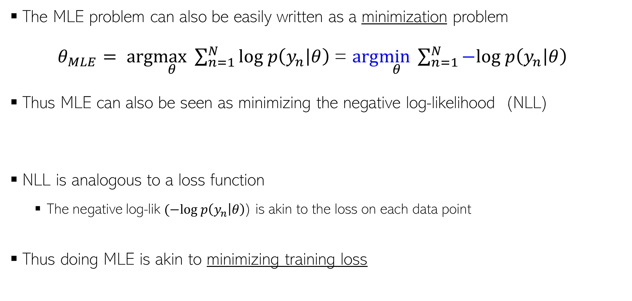
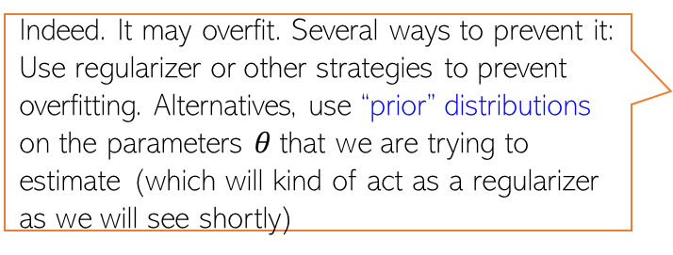

Maximum Likelihood Estimation (MLE)
Negative Log-Likelihood
(NLL)
The MLE problem can also be easily written as a minimization problem
$θ_{MLE}= arg\max_{θ}\sum_{n=1}^{N}{log p\left(y_{n} | θ\right) }$= $arg\min_{θ}\sum_{n=1}^{N}{−log p\left(y_{n} | θ\right) }$
Thus MLE can also be seen as minimizing the negative log-likelihood (NLL)
NLL is analogous to a loss function
The negative log-lik $(−log p\left(y_{n} | θ\right)$) is akin to the loss on each data point
Thus doing MLE is akin to minimizing training loss
Indeed. It may overfit. Several ways to prevent it: Use regularizer or other strategies to prevent overfitting. Alternatives, use “prior” distributions on the parameters $θ$that we are trying to estimate (which will kind of act as a regularizer as we will see shortly)
$θ_{MLE}=arg\min_{θ}$ $NLL(θ)$
Such priors have various other benefits as we will see later
Does it mean MLE could overfit? If so, how to prevent this?

Slide 23
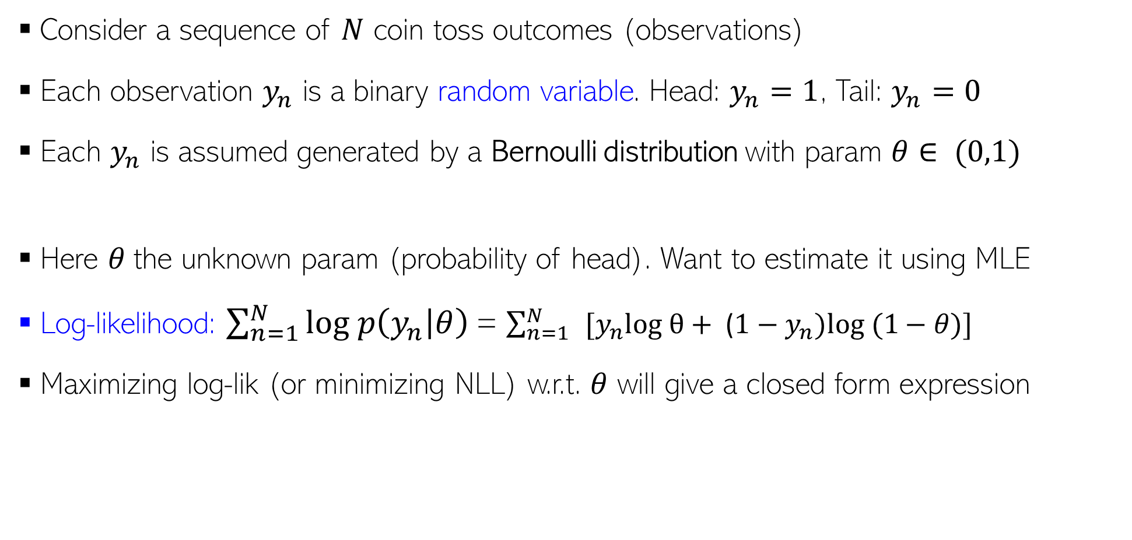
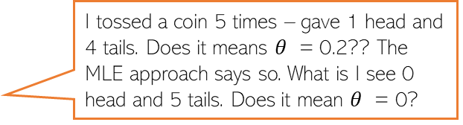

MLE: An Example
Consider a sequence of $N$ coin toss outcomes (observations)
Each observation $y_{n}$ is a binary random variable. Head: $y_{n}=1$, Tail: $y_{n}=0$
Each $y_{n}$ is assumed generated by a Bernoulli distribution with param $θ∈ (0,1)$
Here $θ$the unknown param (probability of head). Want to estimate it using MLE
Log-likelihood: $\sum_{n=1}^{N}{log p\left(y_{n} | θ\right) }$= $\sum_{n=1}^{N}{ }[y_{n}log θ+ \text{(}1−y_{n})log⁡ (1−θ)]$
Maximizing log-lik (or minimizing NLL) w.r.t. $θ$ will give a closed form expression
Probability of a head
$p\left(y_{n} | θ\right)=Bernoulli\left(y_{n} | θ\right)= θ^{y_{n}}$ ${(1−θ)}^{1−y_{n}}$
Take deriv. set it to zero and solve. Easy optimization
I tossed a coin 5 times – gave 1 head and 4 tails. Does it means $θ$ = 0.2?? The MLE approach says so. What is I see 0 head and 5 tails. Does it mean $θ$ = 0?
Thus MLE solution is simply the fraction of heads! Makes intuitive sense!
Indeed – if you want to trust MLE solution. But with small number of training observations, MLE may overfit and may not be reliable. We will soon see better alternatives that use prior distributions!
$$θ_{MLE}= \frac{\sum_{n=1}^{N}{y_{n}}}{N}$$

